Slide 1
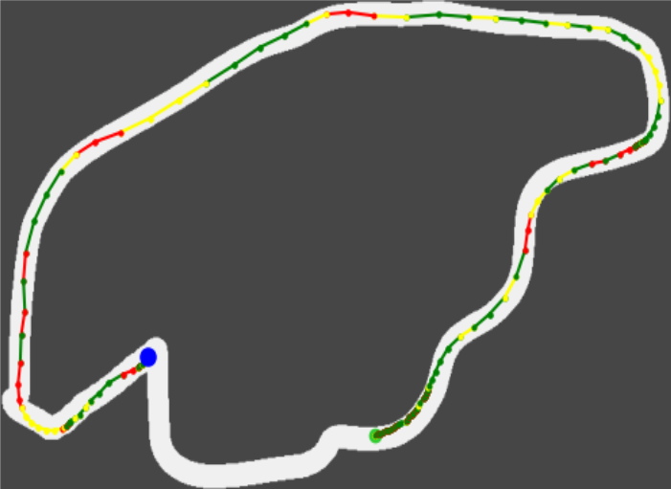
Performance Evaluation:
Car behaviour optimization
Macéo Ottavy, Mathieu Longatte, Louison Mocq

Slide 2
Table of content
Introduction
Racing Car Environment
Genetic Algorithms
Q-Learning
Simulation
Evaluation
Demonstration
Conclusion
1

Slide 3

1) Racing Car Environment
1) Tracks
Track_06.png
2

Slide 4
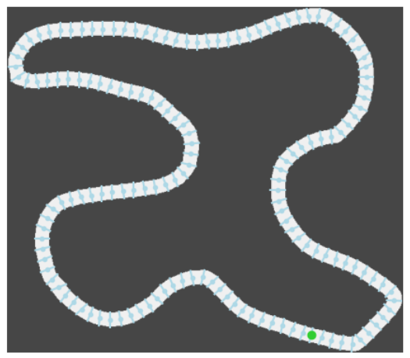
1) Racing Car Environment
1) Tracks
Track_06.png
Track_06_computed
2

Slide 5
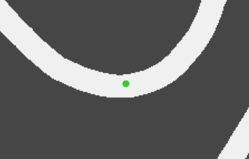
1) Racing Car Environment
2) Car’s physics
Atributes:
3

Slide 6
1) Racing Car Environment
2) Car’s physics
Atributes:
- Speed in [0, MaxSpeed]
Speed
3

Slide 7
1) Racing Car Environment
2) Car’s physics
Atributes:
- Speed in [0, MaxSpeed]
- Rotation in [0, 360]
Speed
Rotation
3

Slide 8
1) Racing Car Environment
2) Car’s physics
Atributes:
- Coordinate
- Speed in [0, MaxSpeed]
- Rotation in [0, 360]
Next coordinates
Speed
Rotation
3

Slide 9
1) Racing Car Environment
2) Car’s physics
Atributes:
- Coordinate
- Speed in [0, MaxSpeed]
- Rotation in [0, 360]
Next coordinates
Speed
Actions:
- Accelerate
- Brake
- Turn
Rotation
3

Slide 10
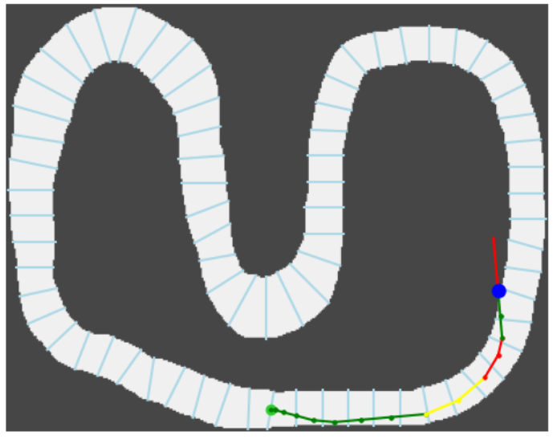
1) Racing Car Environment
3) Example
4

Slide 11
1) Racing Car Environment
3) Example
Acceleration
Brake
4

Slide 12
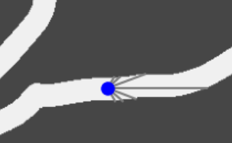
1) Racing Car Environment
4) Interaction with the environment
5

Slide 13
1) Racing Car Environment
4) Reward
R = [10, 1, 2, 12, 13, 13, 13, 14, 24, 14, 13, 12, 13, -497]
6

Slide 14
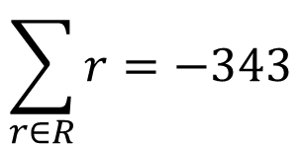
1) Racing Car Environment
4) Reward
$$\sum_{r∈R}^{ }{r}=−343$$
Total reward:
R = [10, 1, 2, 12, 13, 13, 13, 14, 24, 14, 13, 12, 13, -497]
6

Slide 15
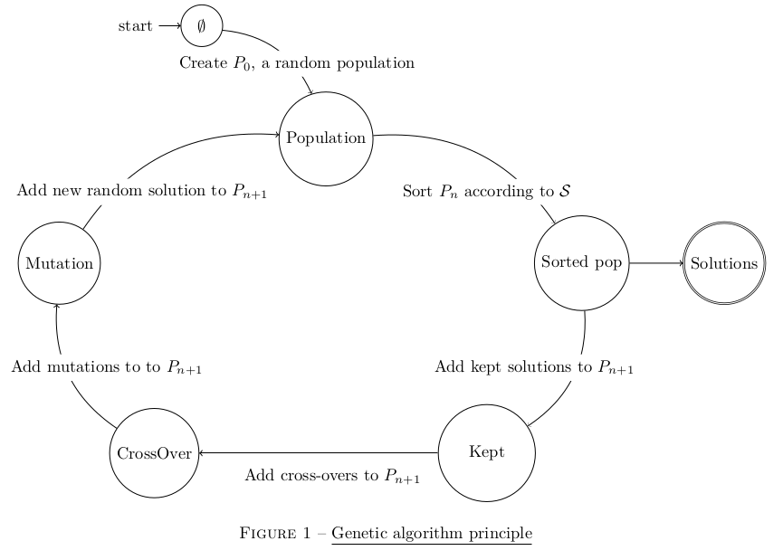
2) Genetic Algorithm
7

Slide 16
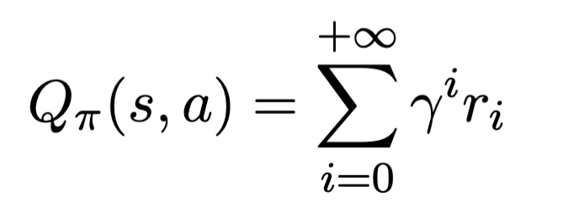
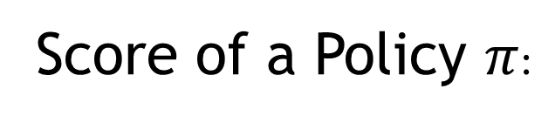
3) Q-Learning
1) Formula
Score of a Policy $π$:
8

Slide 17
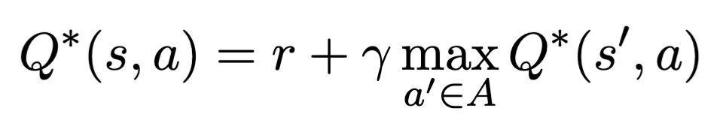
3) Q-Learning
1) Formula
Score of a Policy $π$:
Bellman Equation:
8

Slide 18
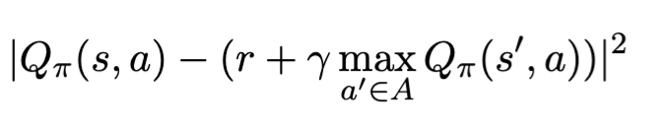
3) Q-Learning
1) Formula
Score of a Policy $π$:
Bellman Equation:
Error:
8

Slide 19

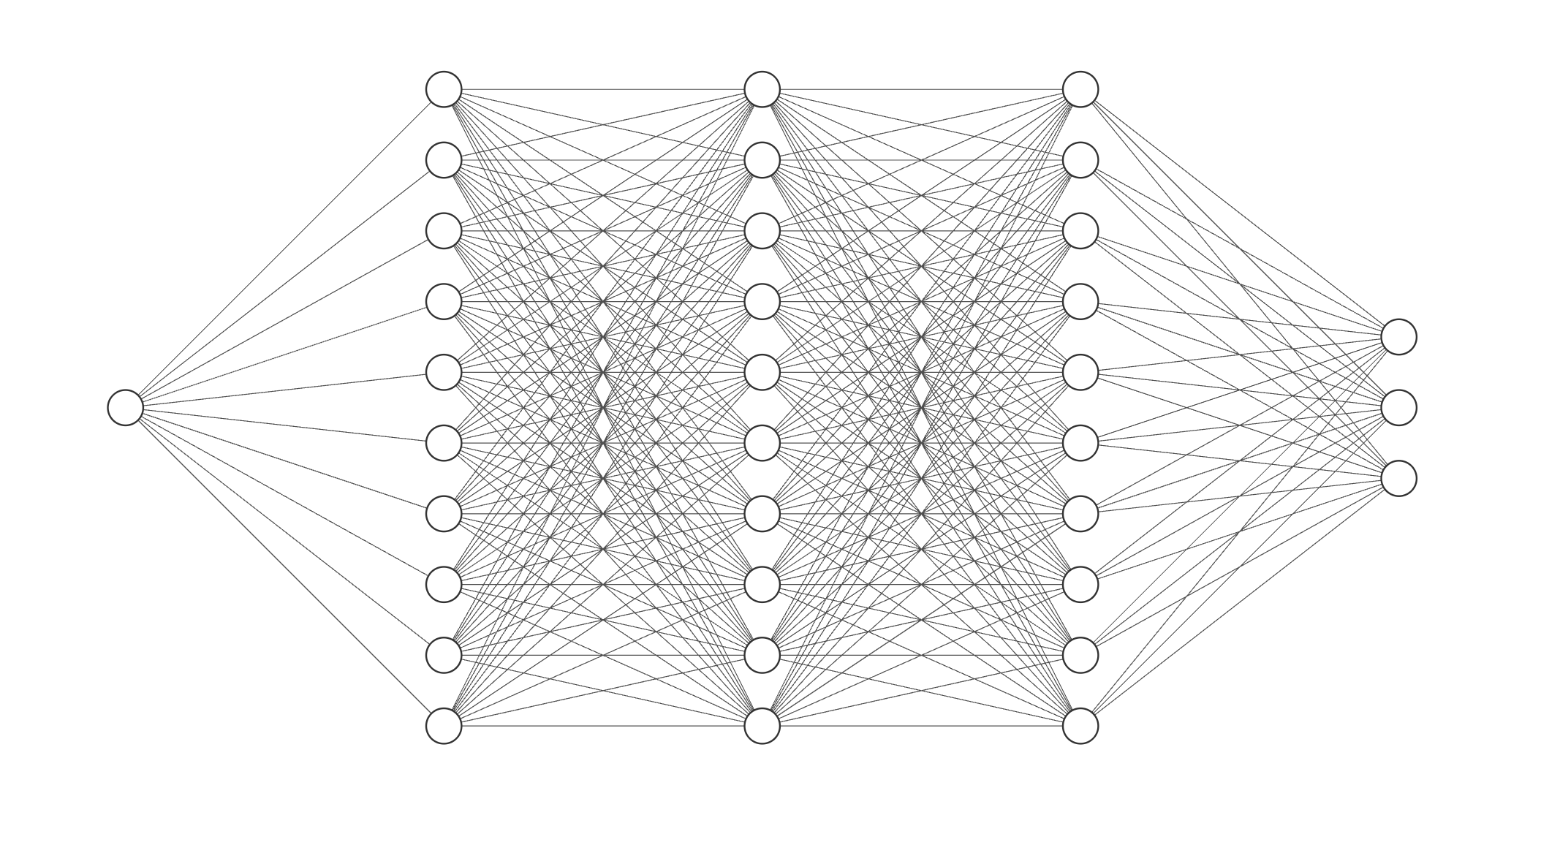
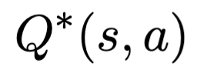
3) Q-Learning
2) Neural network
Goal : Approximate
300000 Parameters
State of the Car
500n
500n
500n
9

Slide 20
3) Q-Learning
3) High level workflow
Choose an action
Observe the reward
Compute the error given by the Bellman equation.
Change the model’s parameters to minimize this error.
Remark: We use techniques to stabilize the training
(mini-batches, ReplayBuffer, epsilon-greedy policy)
10

Slide 21
4) Simulation
1) Objectives
∙Compare the different models used to train the car
∙ Evaluate the best hyper-parameters for the Deep Q model.
∙ Analyse the performance of the best train.
11

Slide 22
4) Simulation
2) How to compares the models?
Same number of CPU/GPU (Grid5000)
We chose to change the number of training tracks and the training time
We chose to evaluate on the average reward and the volatility of the trained car
12

Slide 23
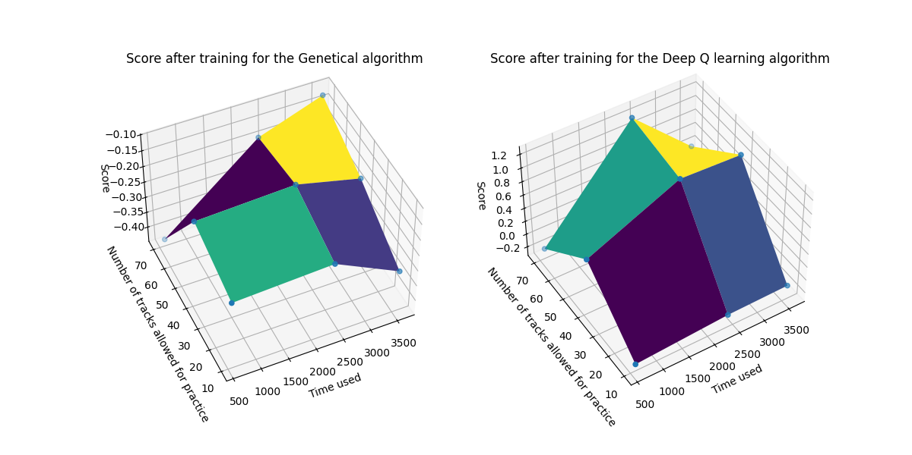
5) Evaluation
1) Q-Learning VS Genetic Algorithms: Reward
13

Slide 24
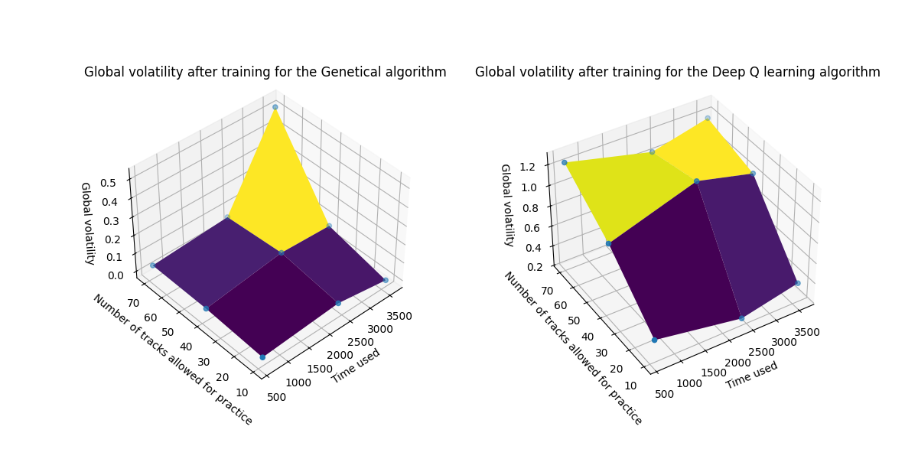
5) Evaluation
2) Q-Learning VS Genetic Algorithms: Volatility
14

Slide 25
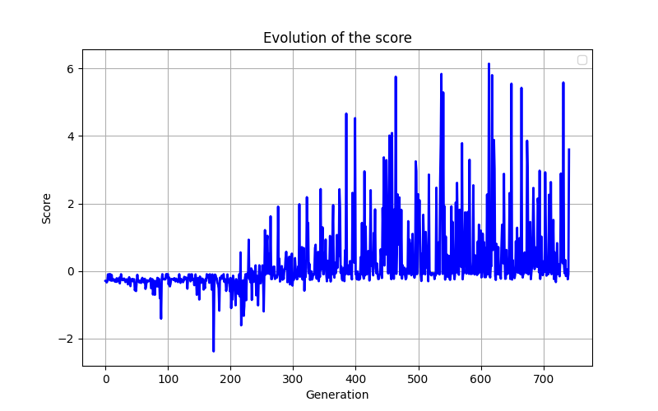
5) Evaluation
3) Q-Learning Rewards
15

Slide 26
5) Evaluation
3) Q-Learning Rewards
Overfitting
15

Slide 27
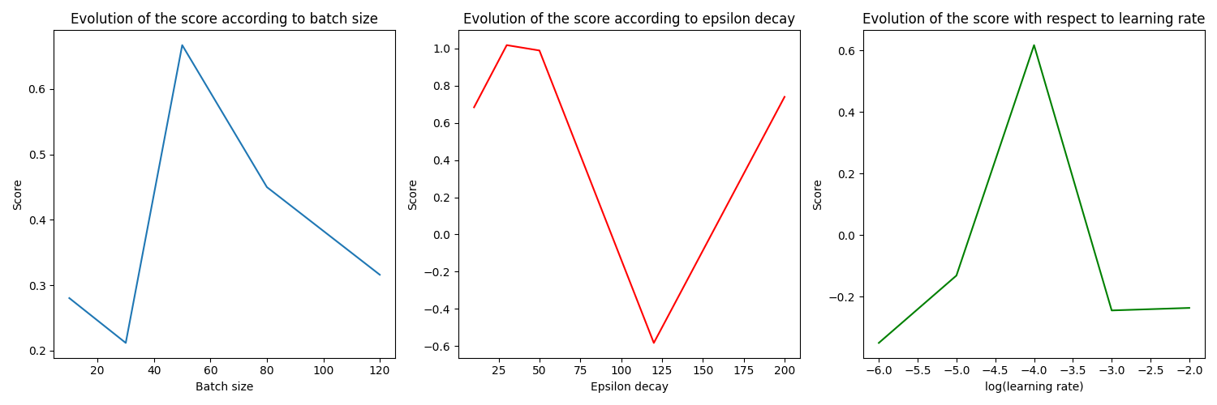
5) Evaluation
4) Best hyper-parameters
16

Slide 28
6) Demonstration
17

Slide 29
7) Conclusion
Results:
- Deep Q-Learning outperforms Genetic Algorithms
- Impressive generalization of the model to new tracks
18

Slide 30
7) Conclusion
Results:
- Deep Q-Learning outperforms Genetic Algorithms
- Impressive generalization of the model to new tracks
Limits, Future Work:
- Explore the dependence on other hyperparameters
- Complexify the physics of the car
- Overfitting
18

Slide 31
Thanks you for your attention
Macéo Ottavy, Mathieu Longatte, Louison Mocq

